Slide 1
OpenGL
Rendering of meshes and models
Advanced Graphics Programming

Slide 2
VAOs, VBOs, and IBOs

Slide 3
Definitions
VBO (Vertex buffer object)
Buffers in the GPU that contain the actual geometry data (positions, normals…)
IBO / EBO (Index / element buffer object)
Buffers in the GPU with indices describing the order in which to render the VBO.
VAO (Vertex attribute object)
State object that contains the association between the vertex attributes required by a vertex shader and the corresponding vertex data in a VBO.
Shorter: it is a link between vertex shader attributes and the data in a vertex buffer object

Slide 4
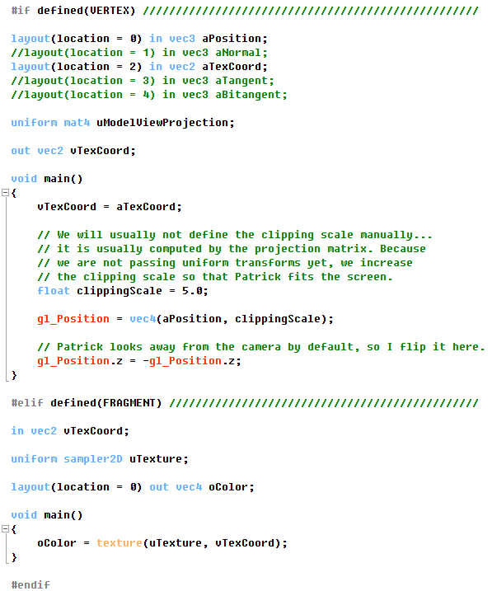
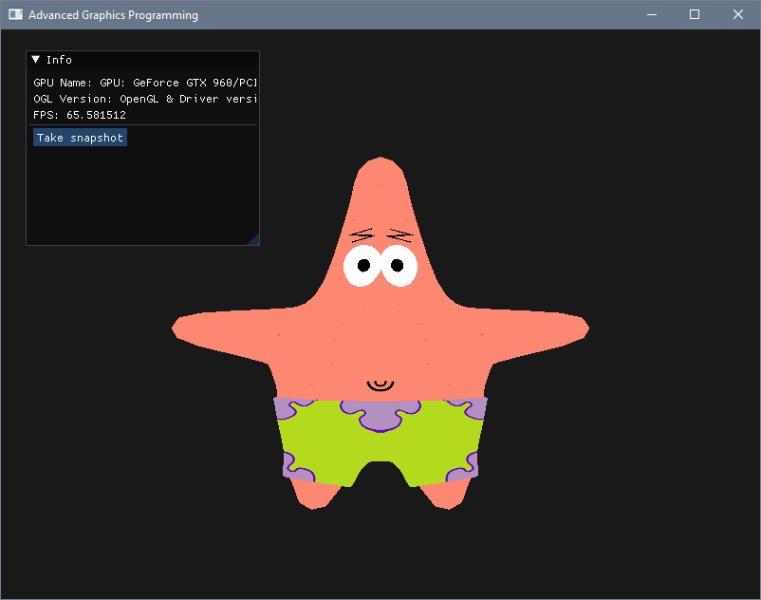
A simple shader to render model albedo

Slide 5
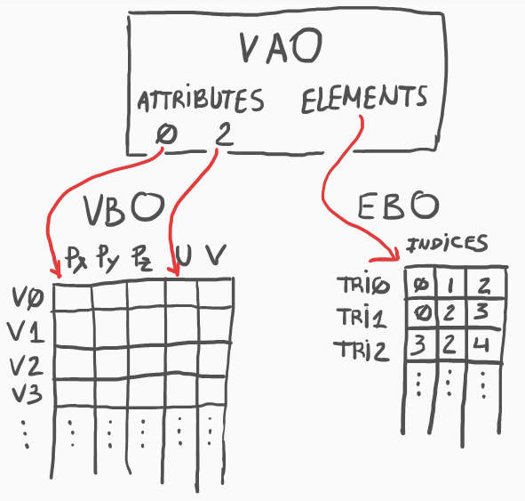
A simple shader to render model albedo

Slide 6
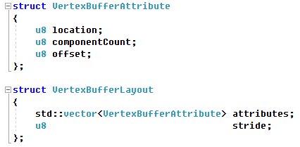
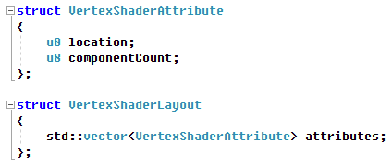

A few structs to organize this VBO / EBO / shader / VAO stuff
What attributes does the VBO contain?
What attributes does the shader require?
How do we relate the VBO with the shader attributes so the GPU can draw?

Slide 7
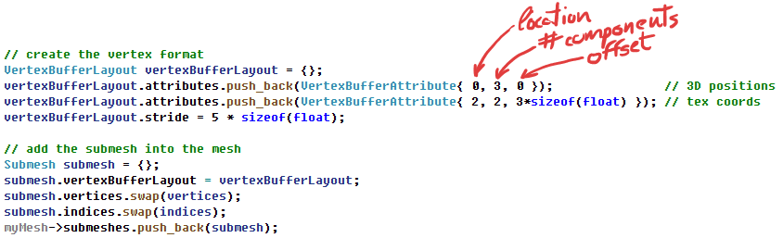
A few structs to organize this VBO / EBO / shader / VAO stuff
What attributes does the VBO contain?

Slide 8

A few structs to organize this VBO / EBO / shader / VAO stuff
What attributes does the shader require?
When we load a program, we should fill its vertex input layout with the attributes it requires

Slide 9

Vertex shader layout reflection

Slide 10
Fill input vertex shader layout automatically
Remember this lines?
They fill the vertex shader input layout of a program after loading it…
Having to write this every time we load a program is very tedious…
Plus is redundant because this information is already contained in the shader…
Plus is error prone!

Slide 11
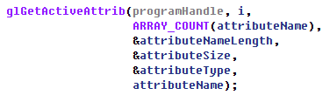
Fill input vertex shader layout automatically
With this, you can obtain the number of attributes in a program
With this, given its index i, you can obtain each attribute name, type, etc...
With this, given the attribute name, you can obtain each attribute location

Slide 12
Model resources

Slide 13

Models and materials
Within our application instance, we can maintain all the resources in an array...

Slide 14
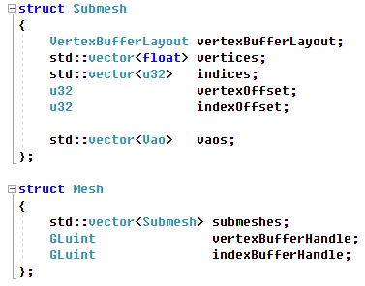
Models and materials

Slide 15
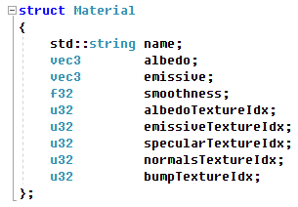
Models and materials

Slide 16

Models and materials

Slide 17
How to draw our meshes

Slide 18
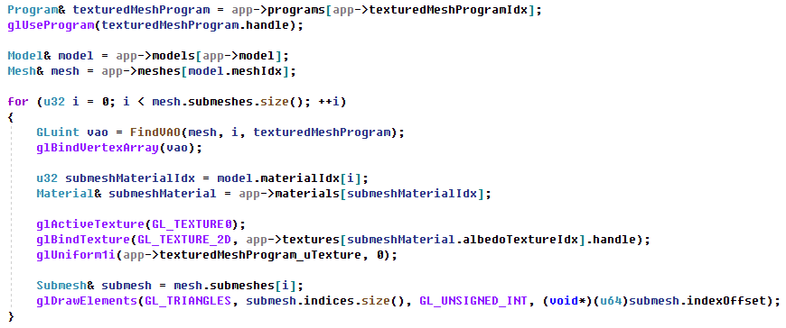
How to draw our meshes

Slide 19
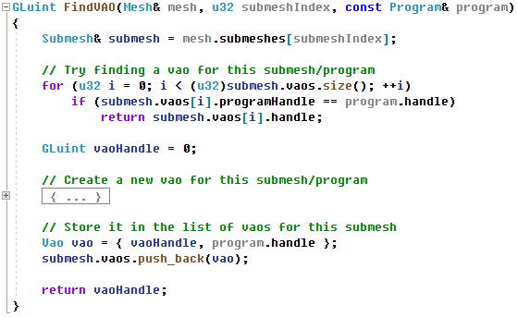
How to draw our meshes

Slide 20
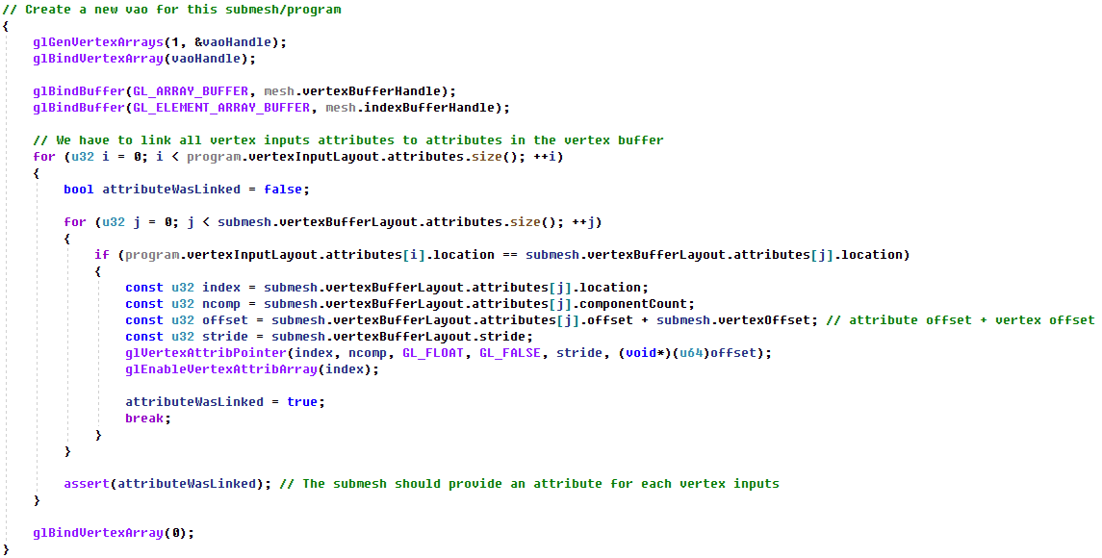
How to draw our meshes

Slide 21
Procedural mesh creation

Slide 22
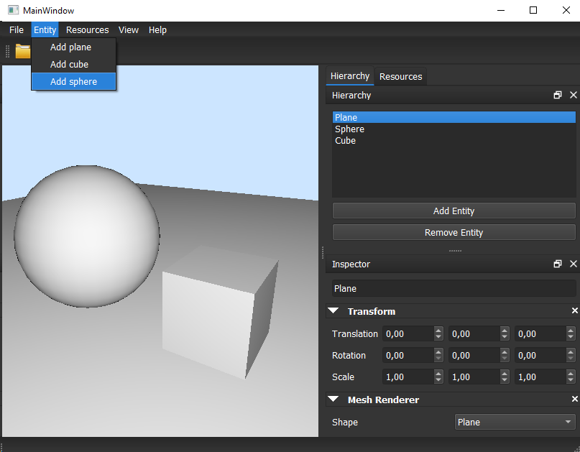
Built-in meshes
All rendering engines have built-in meshes for different purposes:
Prototyping
Debugging placeholders
Rendering purposes
Try to generate some common meshes during the initialization of the application so they can be used later.

Slide 23
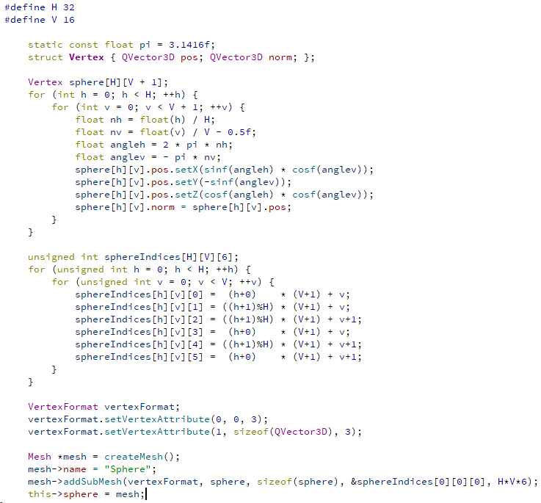
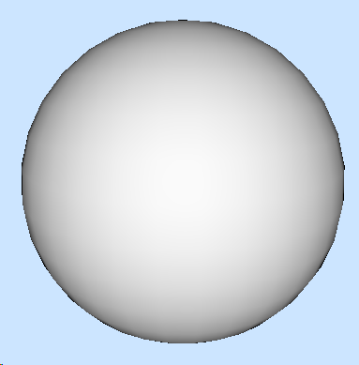
Creation of a sphere mesh

Slide 24
Loading models with Assimp

Slide 25
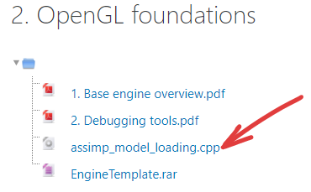
Download assimp loading functions

Slide 26
TODOs
Move the textured quad vertices to a mesh object and adapt your code to use VertexBufferLayouts, VertexInputLayouts, and VAOs
No need to create a Model for this if you do not want, just a Mesh will be enough
Automatize the VertexShaderLayout creation when calling LoadProgram( )
Add the Assimp loading functions available in the Atenea campus and load / render the Patrick model with the shader at the beginning of the slides.
Create a few embedded submeshes (e.g. a floor-aligned plane, a cube, a sphere…) with their vertex positions and normals and store it in the same buffer where the initial textured quad is stored.

Slide 27
Patrick says:
Please, do your homework… I look very ugly like this :-(

